Slide 1

Software Application
for Business
Group H
Penuel Maypa
Christopher Musitongo
Jodeyne Teneza
Rehan Naeem
Ltd.

Slide 2
MCTV Ltd
MCTV is a small retail Company
Micheal & Dooren Cooney
Based in Limereck
Trading over 20 Years
Annual Turnover 1 million euro

Slide 3
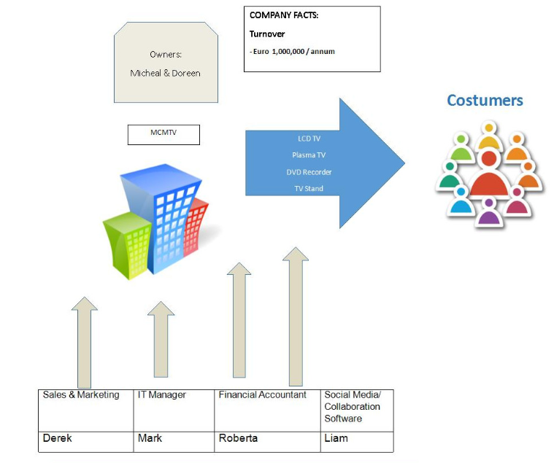
Visual Representation of the current Business Model

Slide 5
Roles of the Member
Derek - Sales & Marketing
Liam - Social Media/ Web Designer
Mark - IT Manager
Roberta - Financial Accountant

Slide 6
Roles of the Member
Derek - Sales & Marketing
Penuel (TEAM LEADER)
Liam - Social Media/ Web Designer
Jodeyne
Mark - IT Manager
Christopher
Roberta - Financial Accountant
Rehan

Slide 7
Jodeyne Teneza
Web Design & Social Media
-- Liam

Slide 8
Roles & Responsibilities in the Company
Web Designer/Developer
Social Media
Logo Designer
Colour Scheme

Slide 9

Color Scheme
Logo

Slide 10
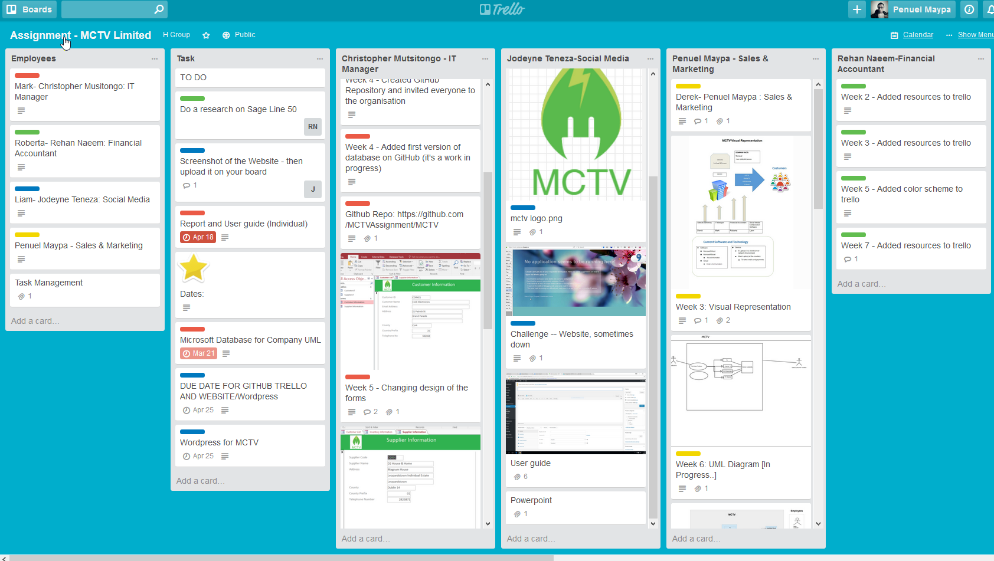
Trello

Slide 11
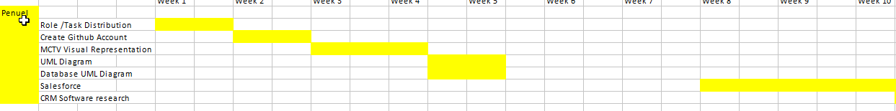
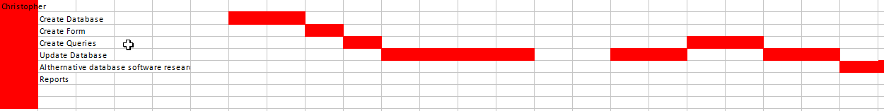
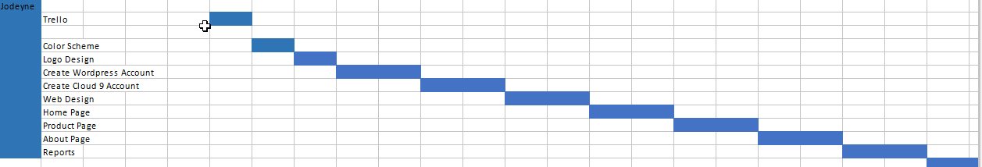
Gantt Chart

Slide 12
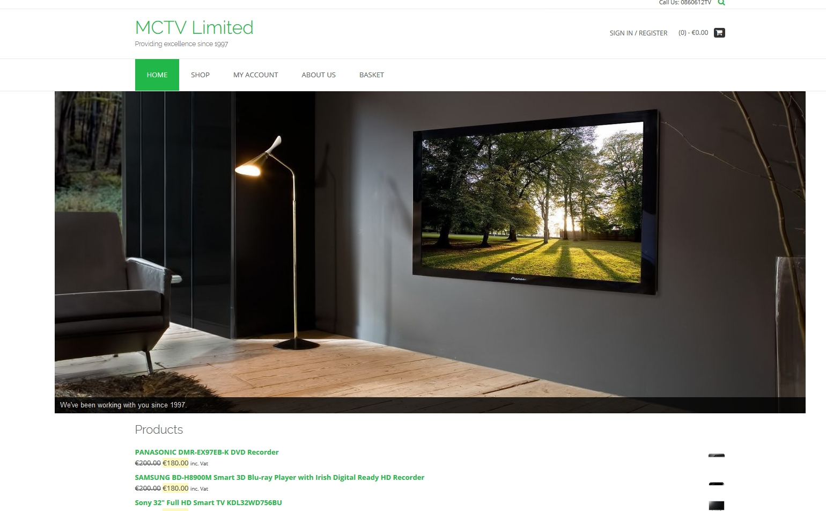
Website: Home

Slide 13
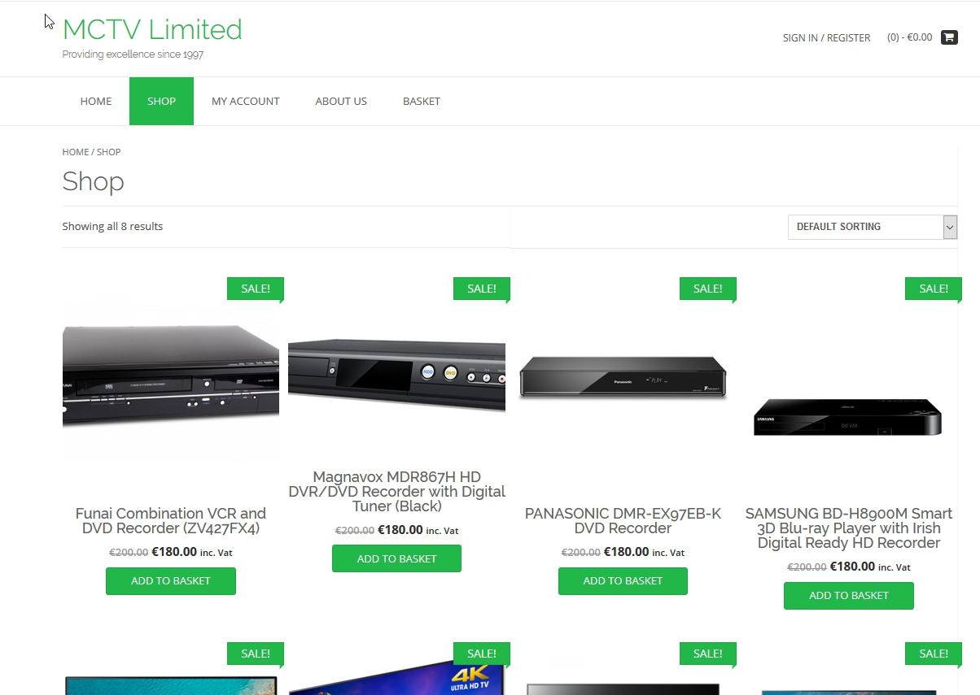
Website: Shop

Slide 14
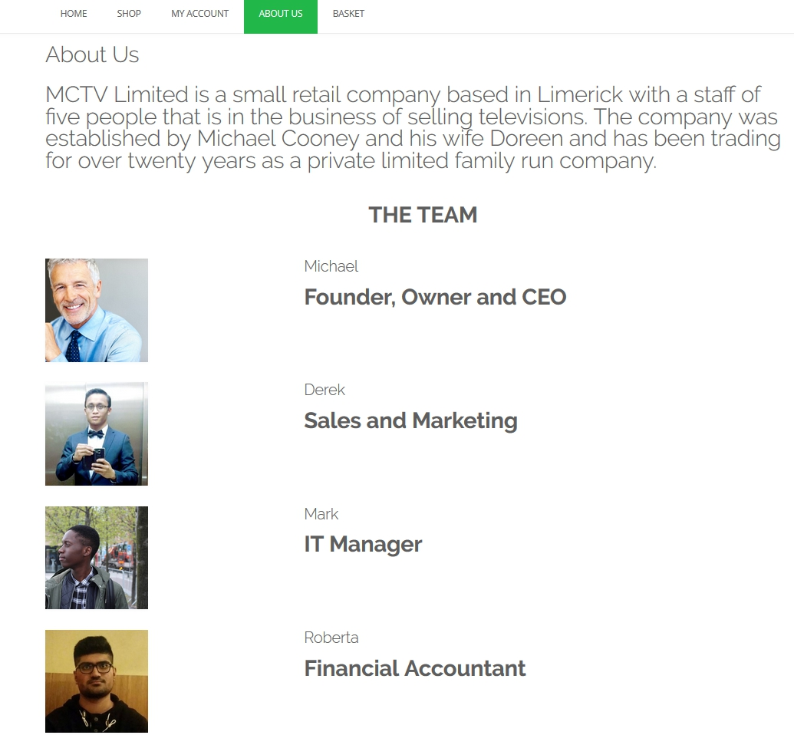
Website: About Us

Slide 15
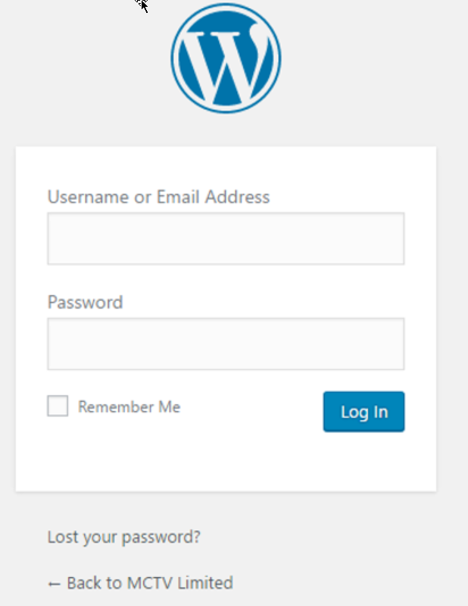
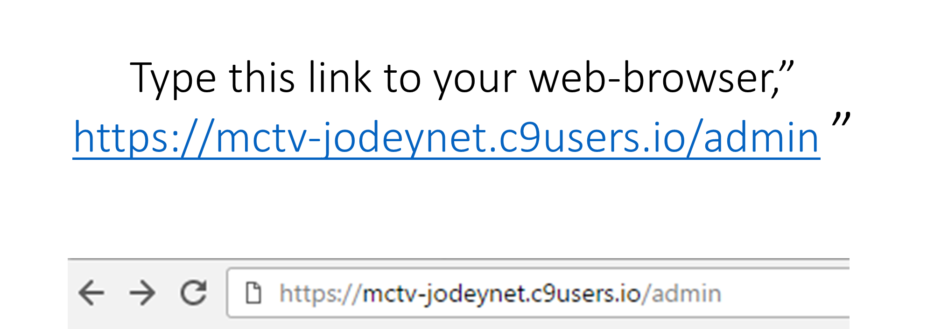
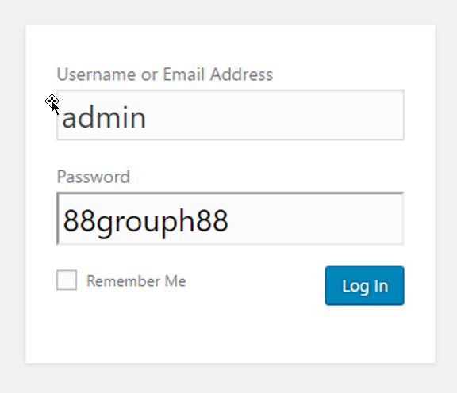
User-Guide

Slide 16
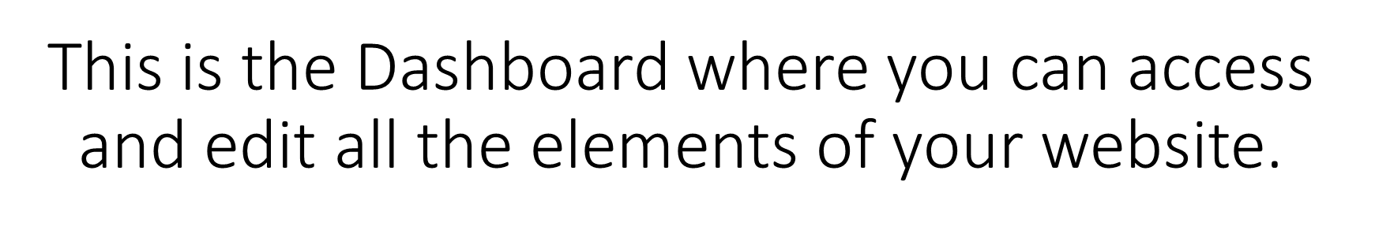
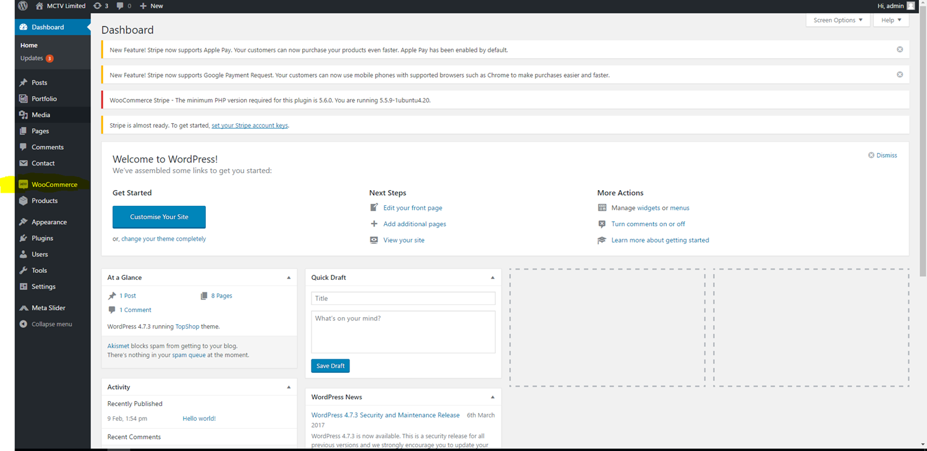
User Guide: Dashboard

Slide 17
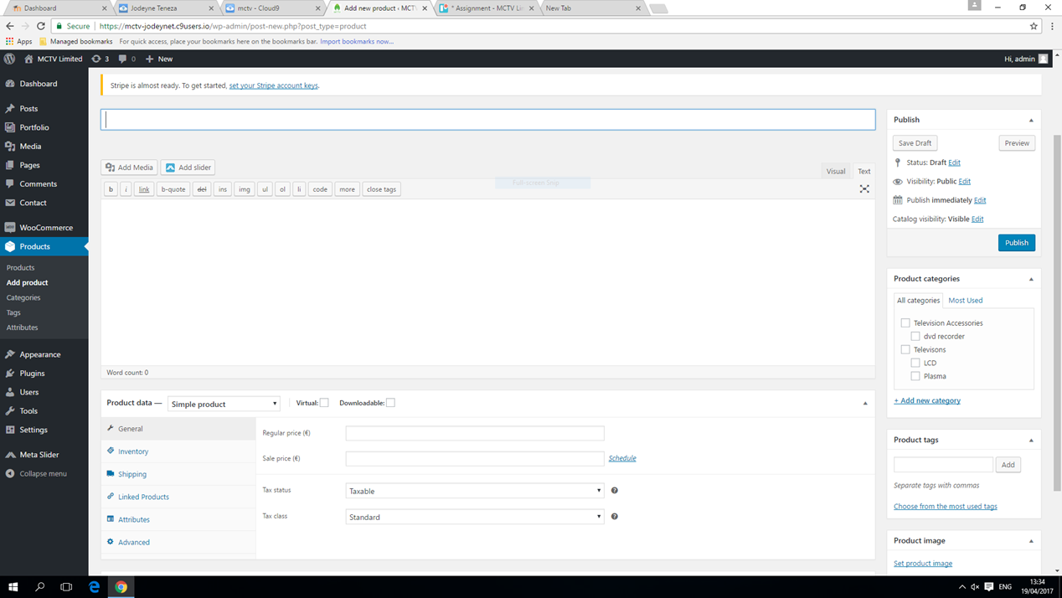
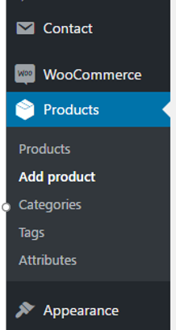

User Guide: Dashboard

Slide 18

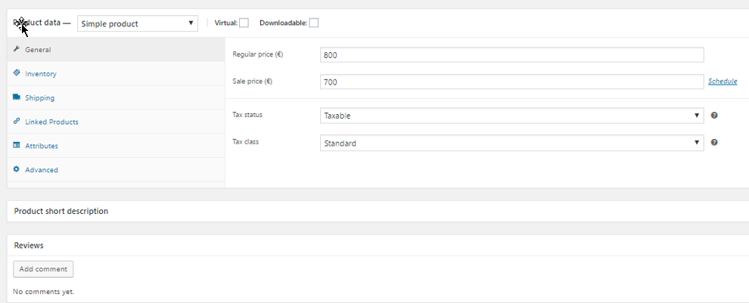
User Guide: Dashboard

Slide 19
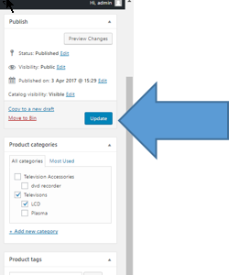
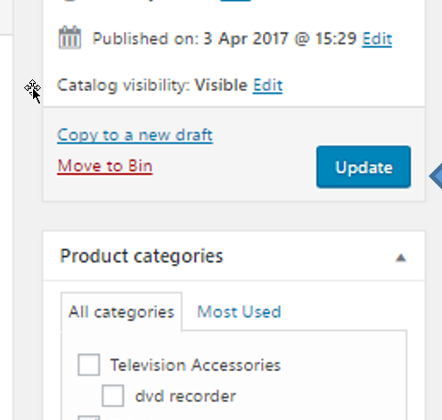
User Guide
Like so and then press update

Slide 20
Christopher Musitongo
IT MANAGER
-- Mark

Slide 21
Roles & Responsibilities in the Company
Creating and managing the database
Managed GitHub
Collaborated with Liam (Jodeyne) in making the website
Helped design the website
Helped with UML Diagram
Advising the team

Slide 22
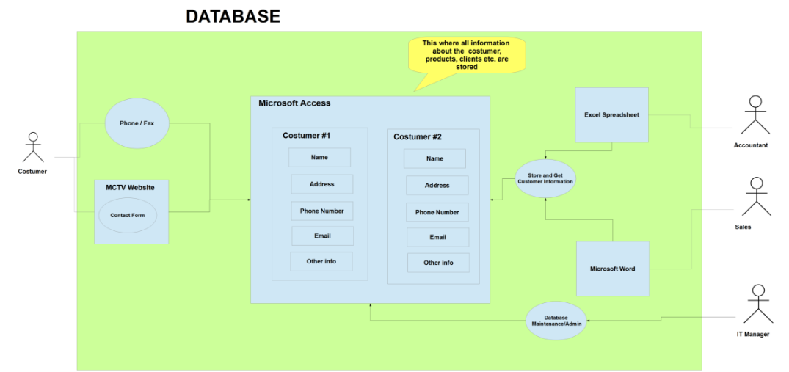
UML Case

Slide 23
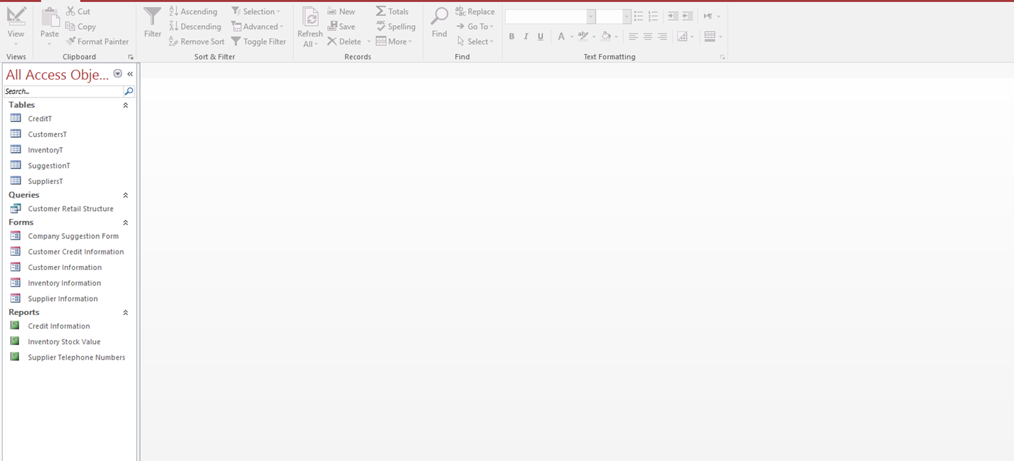
The Database - Interface

Slide 24
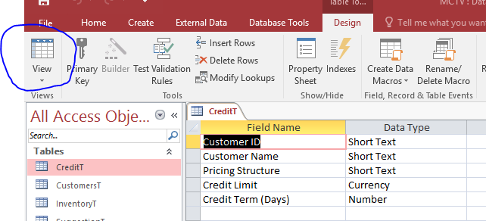
The Database – Design View
To edit tables, forms, queries and reports you can click this view and then “Design View”

Slide 25
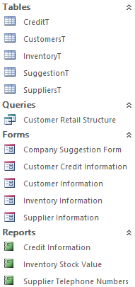
The Database - Sidebar
Tables – In this tab, you can access all the tables which contain information such as all the customers and suppliers that MCTV are collaborating with.
Queries – With queries you can filter out certain information, making it easier to find the information you desire.
Forms – You can access all the different types of forms that MCTV use. This information is stored in the tables tab.
Reports – For accessing certain reports that MCTV uses.

Slide 26
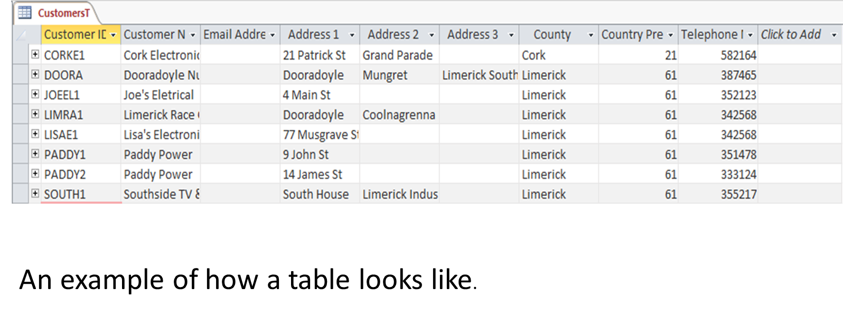
The Database - Tables

Slide 27
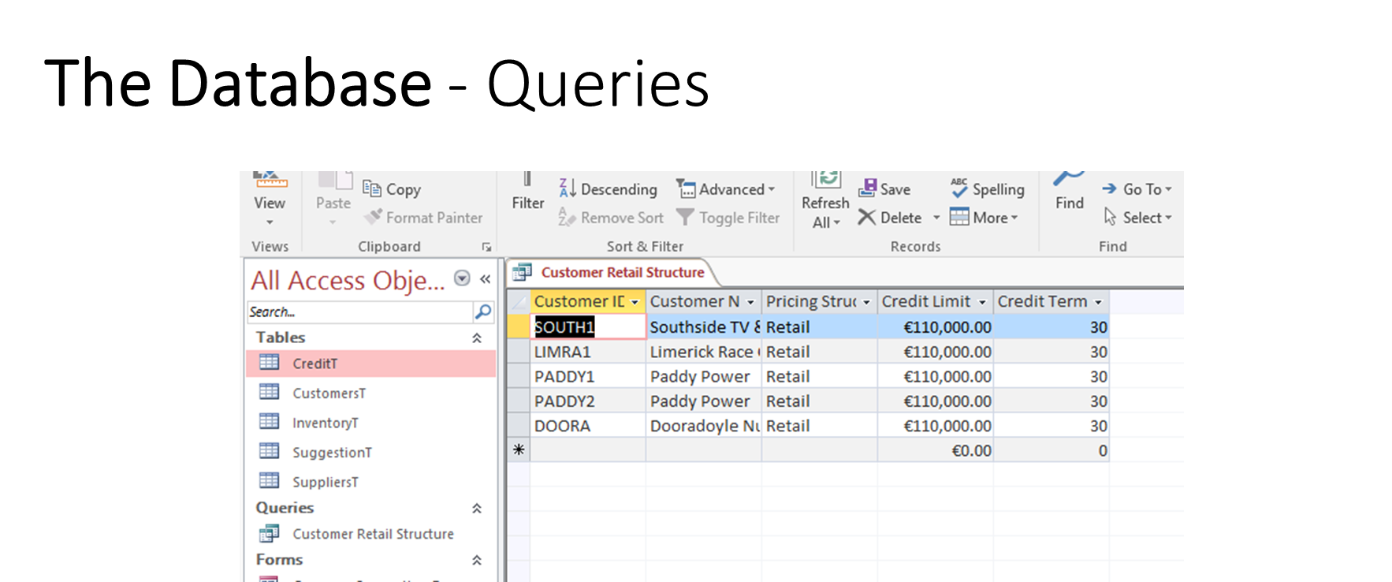

Slide 28
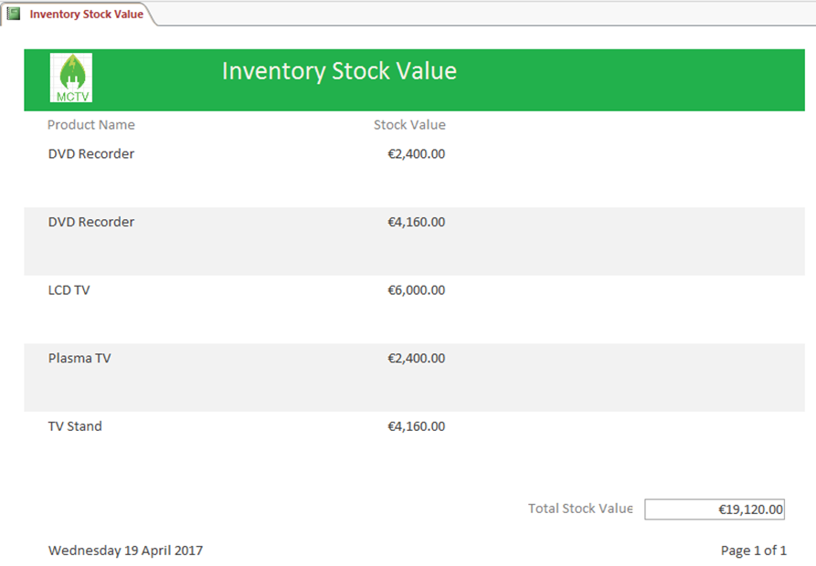
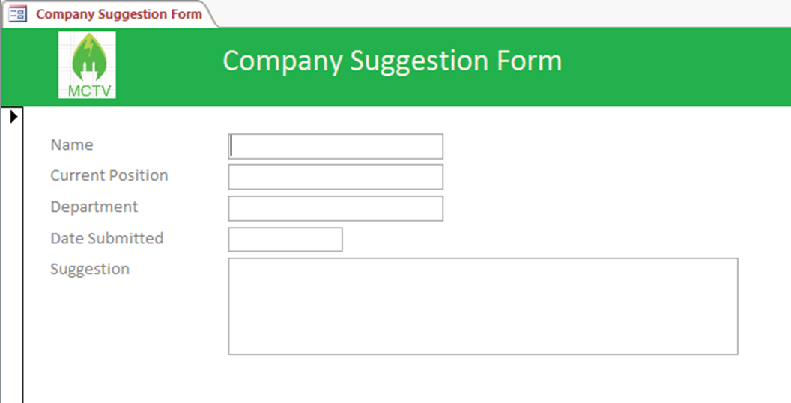
One of the forms located in the database
Report will always display the date accessed

Slide 29
Conclusion
The database can be easily managed by IT if they’re proficient in Access
It’s a lot easier to access all the information they require
It will replace the paper based system that is currently being used
If MCTV move to the cloud, it will make it easier to transfer their data

Slide 30
Rehan Naeem
Financial Accountant
-- Mark

Slide 31
Roles & Responsibilities in the Company
Book Keeping
Financial Controller
Review Profit/Loss

Slide 32
Sage Line 50
Sage 50 is an accounting software used by small and medium sized companies.
It is designed to streamline all of your accounting routines, reduce your data entry and save you time.
Creates a complete business management system offering multi user and multi company configurations to suit all business types.
It works seamlessly with other software such as Microsoft excel

Slide 33
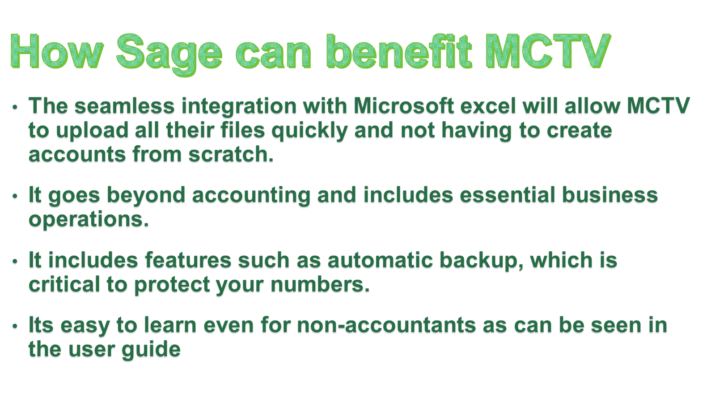

Slide 34
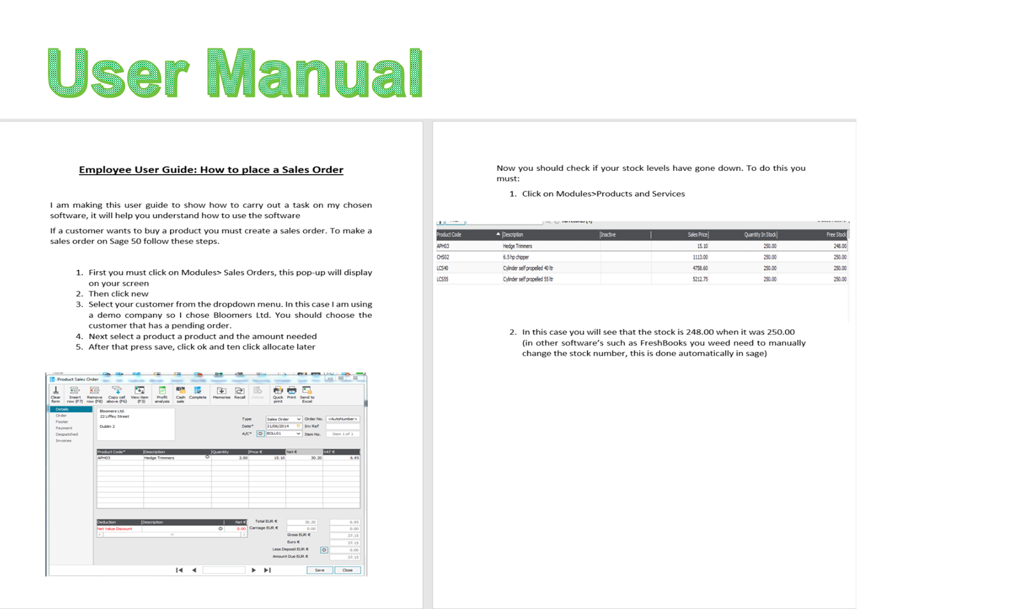

Slide 35
Penuel Maypa
Sales & Marketing
-- Derek

Slide 36
Roles & Responsibilities in the Company
Customer Service
Customer Relations
Sales Representative

Slide 37
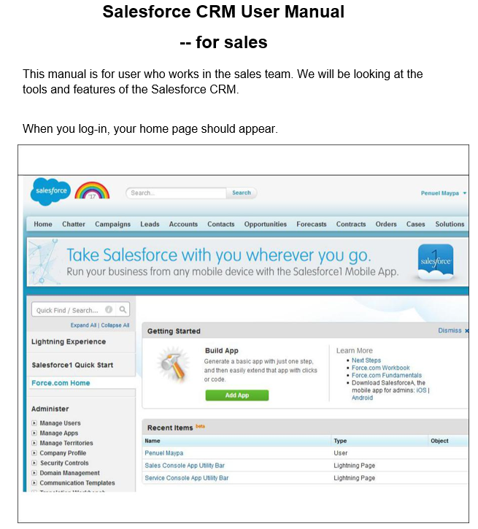
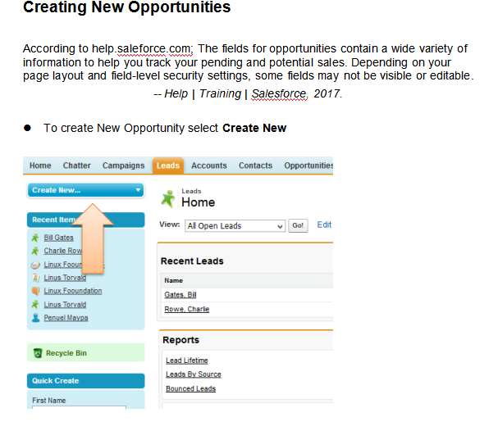
Salesforce - User Manual

Slide 38
Future Development of the Company
In 5 Years
Employ 10 more employees
New branch in Cork
Start supplying electronics to businesses
We plan to expand our choices of products

Slide 39
Thank You

